Slide 1

Sirius AI Consulting Financial Services August’2023

Slide 2
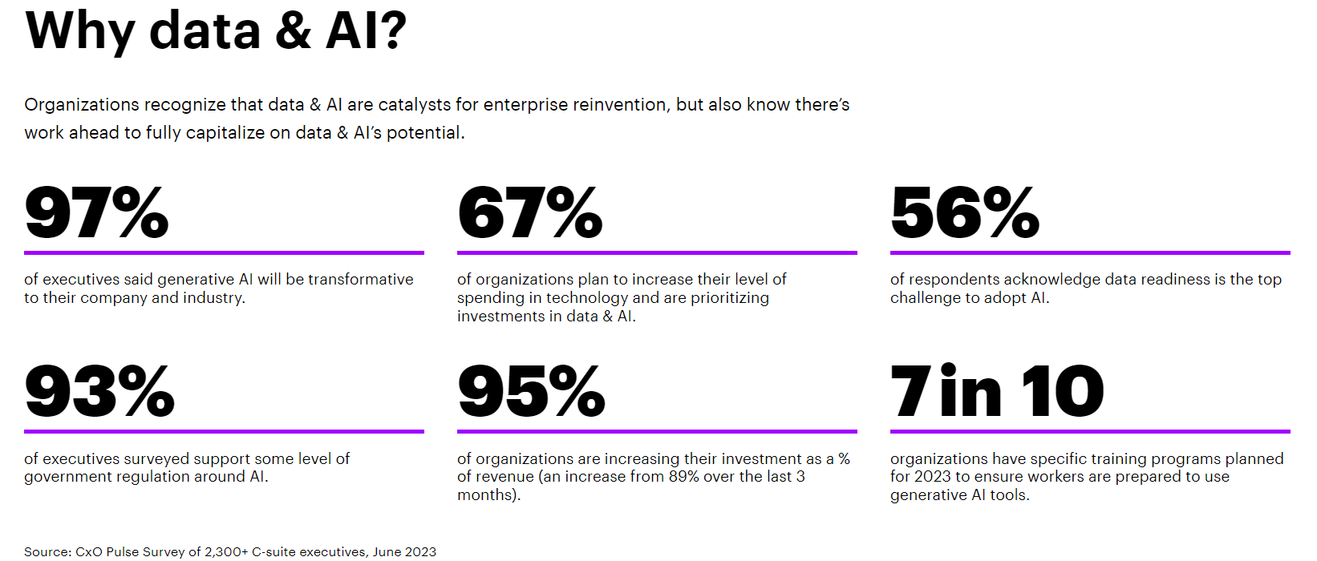
SLIDE or SECTION 1:
STATE OF AI
STATE OF AI
Notes:
EVOLUTION OF AI – GEN 0 GEN 1 GEN 2
FRAME WORK & USE CASES – RELEVANT ONES
GAP in FS
YOUR POSITION IN THE MATURITY CURVE
TEMPLATE
TEAMS ROLES & PHOTOS
INFRASRUCTURE

Slide 3
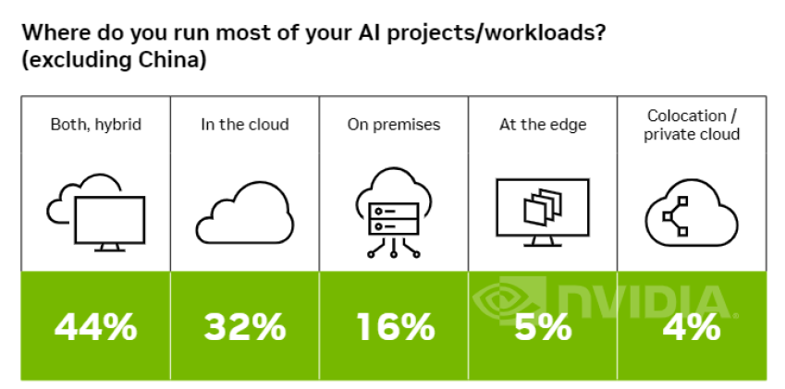
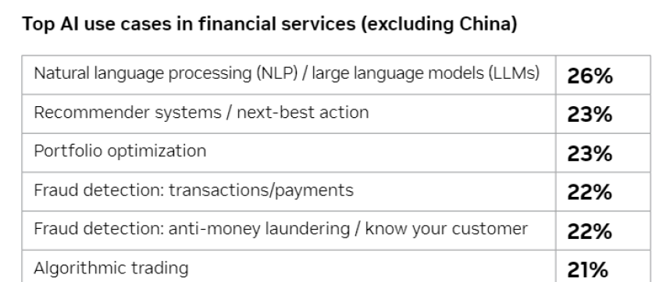
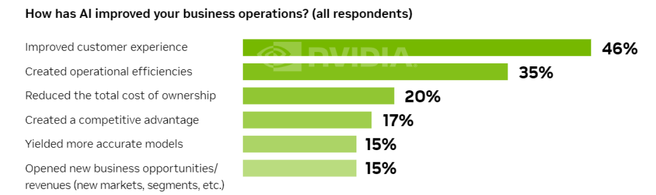
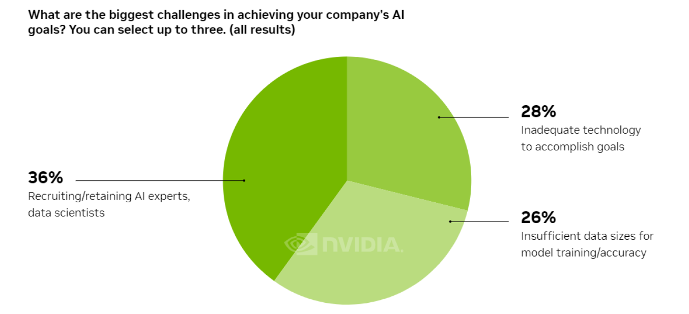
SLIDE or SECTION 1:
STATE OF AI
STATE OF AI IN FINANCIAL SERVICES
Adoption of AI use case continues to Accelerate
NEED TO REDUCE COSTS
Migration to clouds
AI applications are creating significant value in FS
Hiring & retaining data scientists
ESG & Sustainability focus

Slide 4
SLIDE or SECTION 2:
FS PAIN POINTS
PAIN POINTS OF FINANCIAL SERVICES CLIENTS

Slide 5
SLIDE or SECTION 3:
WE ARE SIRIUS AI
WE ARE SIRIUS AI

Slide 6

SLIDE or SECTION 4:
SIRIUS OFFERINGS & SERVICES
Different Modes of Value creation for clients
Our firm aims to create client value at multiple levels, including setting a data brain as a rich set of data & insights products, accelerating consumption of insights across the enterprises with repeatable and scalable AI tech solutions that can be rapidly deployed across clients
Business problem solving with use case prioritization for AI, business insights & end user consumption of AI capabilities
Monitor, track and govern usage and adoption of data and AI across an enterprise
AI Consulting
Wide variety of 3rd party data assets and ecosystem partnerships
Ability to create unified data models and industrial scale data products using 1st, 2nd and 3rd party data
Data Brain
E2E AI tech services with integrated cloud platform, data & ML foundations and AI solutions workbench
Scaled AI solutions with data & insights democratization across the enterprise
AI Tech

Slide 7
SLIDE or SECTION 5:
SIRIUS DIFFERENTIATORS
Bringing it together for clients, with ease and speed
05
Ready to Use Data, AI and Technology Platform Services
Client Value Realization
Pre-built solutions stitched with data assets, AI accelerators and platform services
04
Scalable Platform and Technology Assets
03
Industry Knowledge & Context
Learnings from multiple client experience, proven expertise in implementing projects, industry specific contextualization
Ecosystem partnerships and experience with multiple cloud platforms, library of advanced AI algorithms for industry specific use cases
02
Data Assets
Talent & Expertise
01
Ecosystem of 1000+ data originators, aggregators, and exchanges with a pre-designed library of data & insights products
A strong founding team coupled with a vast talent network of AI and machine learning professionals, data scientists and SMEs

Slide 8









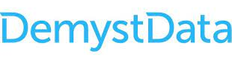


Rich customer centric information universe, enabled through data products
SLIDE or SECTION 5:
SIRIUS DIFFERENTIATORS
Our team brings in a unique blend of knowledge and experience of sourcing, integrating and contextualizing a massive data ecosystem to accelerate value realization for different AI use cases in Financial services
Data Procurement
Data Models
Data Assets
FS Industry Contextualization
Client Data & Synthetic Data
Wealth Management
Client 360
Advisor 360
Customer Profile & CRM
Product & Portfolio
Transactions & Records
Asset Management
Channel 360
Data Providers & Service Firms
Demographics
Marketing & Interactions
Risk & Delinquency
Portfolio 360
Banking
House-hold 360
Income & Affluence
Geo Location & Mobility
Digital Personas
Payments
Data Aggregators & Marketplaces
Enterprise 360
Illustrative List Only

Slide 9
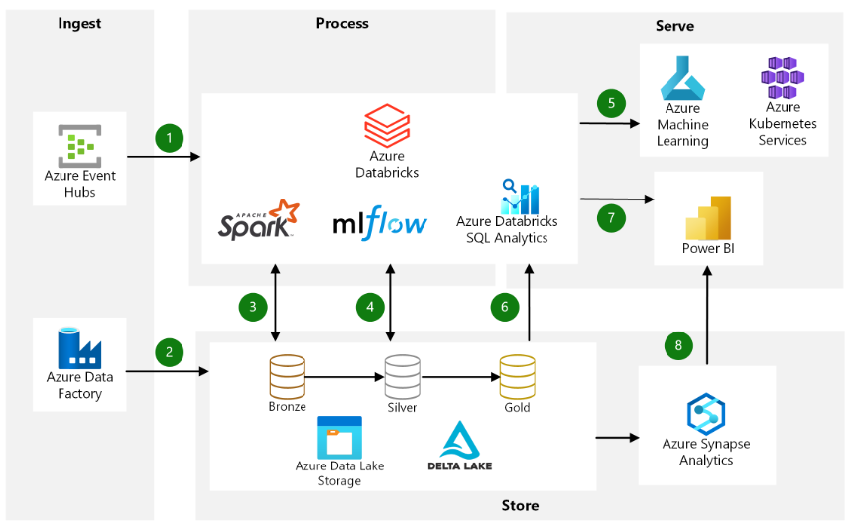
Leverage the best-in-class cloud and data platform innovation
SLIDE or SECTION 5:
SIRIUS DIFFERENTIATORS
Build suite of data products on Azure with Databricks, stay cloud agnostic, offer superior integration with Microsoft technologies and create a scalable technology stack
Azure’s adoption is growing very fast, and due to its seamless integration with Microsoft tools, simplicity and wide functionality it will make it easy to build applications on it.
Databricks is extremely flexible & easy to setup, offers superior ML Ops functionality designed to handle large ML workloads, performs faster than others. All of the Databricks workflow can be ported to other clouds easily

Slide 10
Getting ready for the launch
SLIDE or SECTION 5:
SIRIUS DIFFERENTIATORS
TALENT
TECHNOLOGY
DATA
CLIENT OUTREACH
Core founding team with experience and expertise in Financial Services AI consulting
AI and Technology workforce skilled in architecture, data foundation & ETL, ML and AI algorithms, Devops and ML ops.
Sales and marketing consultants for GTM for client outreach
Product engineering squad to kickoff the development
Azure- Databricks sandbox to build and deploy data products
Essential software subscription like Gitlab, VPN, MS Teams etc. to enable remote working
Partnership with Databricks for Data Streaming and Pipeline, AI Development and ML Ops accelerators and connectors
Partnership with Salesforce/Consumption platform of lighthouse client
Data ecosystem partnerships with data vendors, aggregators and marketplaces
First set of vendor contracts with data provider for wealth dataset (such as Adstra, WealthX), consumer demographics and digital profiling datasets etc.
Vendor partnership with data onboarder for interlinking and unified data model
Identify lighthouse client for pilot and use case experimentation
Define partnership model with lighthouse client to leverage & onboard client data and create prototype with our firm’s investment
Design GTM capability and define a client outreach program to build a steady pipeline for Y1 and Y2

Slide 11



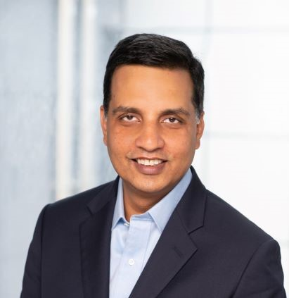
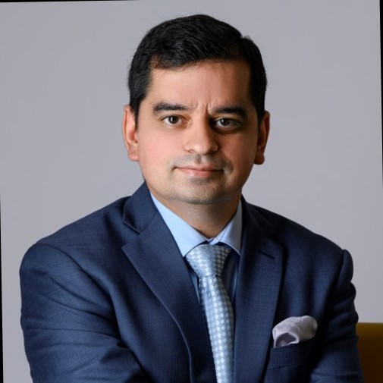

SLIDE or SECTION 6:
THE TEAM
Founding Team is AI Native
Breadth of experience in advising 100+ enterprises in Banking, Capital Markets, Payments, Insurance, Retail, Telco, CPG
Building new AI, Analytics and Data businesses running into several hundred million dollars in annual revenues.
Combined experience of creating talent pool of over 5000+ professionals over a couple of decades
Founder
Founder
Sanjay is one of the early adapters of AI wave and has created new businesses grounds up for three large global consulting firms. He has extensively worked in several markets worldwide, with majority of time in New York, Charlotte and San Francisco area
Abhinav is an AI, ML & data solutions leader, and has established high performing team across global practices. He championed the setup of Center for Data & Insights global practice and Accenture, helping build a suite of products for financial services clients.
Sanjay Ojha
IBM Consulting – Senior Partner
Ex Accenture – Managing Director
Ex GE/Genpact – Vice President
Abhinav Vij
IBM Consulting – Partner
Ex Accenture – Managing Director
Ex ICICI Bank – Analytics Manager
Sponsor
Narendra brings decades of experience in creating value for the future 1000 and has the distinction of having built and scaled Accenture’s Analytics and AI business from scratch. He has helped many clients unlock trapped value & define new ways to disrupt in their markets.
Narendra Mulani
Advisor, Investor & Board Member at multiple AI Service firms,
Ex-Accenture, Ex-iRi

Slide 12
Engagement Models
SLIDE or SECTION 7:
ENGAGEMENT MODEL or WAYS OF WORKING
Build and Proof of Value Pilot
Develop AI models and Data backbone
Web/ App updates
Go-Live: Pilot for a segment & measure
Scale Across Portfolio
Commercial model: Fixed fees for Build and Proof of Value pilot
Scale and Expand
Commercial model Options:
a. performance based
b. managed services

Slide 13
Thanks

Slide 14

new opportunities opening UP with Acceleration of AI Adoption
The proliferation of digital-first channels, cloud innovation, open-source technology and ubiquity of data is making AI a key boardroom agenda.
However, making sense of large amounts of data, working across silos, and aligning analytics to business and stakeholder goals continue to be significant challenges for financial services leaders
There is a strong case for partnering with experienced AI service provider. Brining in new capabilities for large and matured enterprises or providing end to end AI & Data capability for mid tier enterprises.
It helps organizations free up internal resources, avoid upfront infrastructure costs and access economies of scale and experience.
The global AI fintech market is predicted to reach $22.6B in 2025, achieving a CAGR of 23.37% between 2020 and 2025 according to Mordor Intelligence.
40%
Gartner predicts that more and more organizations will outsource their data and AI solutions, growing from 6% to 40% outsourced utilization by 2024
Source: Gartner Press Release Jun 7, 2022, “Barriers to Scaling AI Internally Will Lead to Significant Rise in the Use of BPO Providers”

Slide 15
Founding Team is AI Native
Breadth of experience in advising 100+ enterprises in Banking, Capital Markets, Payments, Insurance, Retail, Telco, CPG
Building new AI, Analytics and Data businesses running into several hundred million dollars in annual revenues.
Combined experience of creating talent pool of over 5000+ professionals over a couple of decades
Founder
Founder
Sanjay is one of the early adapters of AI wave and has created new businesses grounds up for three large global consulting firms. He has extensively worked in several markets worldwide, with majority of time in New York, Charlotte and San Francisco area
Abhinav is an AI, ML & data solutions leader, and has established high performing team across global practices. He championed the setup of Center for Data & Insights global practice and Accenture, helping build a suite of products for financial services clients.
Sanjay Ojha
IBM Consulting – Senior Partner
Ex Accenture – Managing Director
Ex GE/Genpact – Vice President
Abhinav Vij
IBM Consulting – Partner
Ex Accenture – Managing Director
Ex ICICI Bank – Analytics Manager
Sponsor
Narendra brings decades of experience in creating value for the future 1000 and has the distinction of having built and scaled Accenture’s Analytics and AI business from scratch. He has helped many clients unlock trapped value & define new ways to disrupt in their markets.
Narendra Mulani
Advisor, Investor & Board Member at multiple AI Service firms,
Ex-Accenture, Ex-iRi

Slide 16
Different Modes of Value creation for clients
Our firm aims to create client value at multiple levels, including setting a data brain as a rich set of data & insights products, accelerating consumption of insights across the enterprises with repeatable and scalable AI tech solutions that can be rapidly deployed across clients
Business problem solving with use case prioritization for AI, business insights & end user consumption of AI capabilities
Monitor, track and govern usage and adoption of data and AI across an enterprise
AI Consulting
Wide variety of 3rd party data assets and ecosystem partnerships
Ability to create unified data models and industrial scale data products using 1st, 2nd and 3rd party data
Data Brain
E2E AI tech services with integrated cloud platform, data & ML foundations and AI solutions workbench
Scaled AI solutions with data & insights democratization across the enterprise
AI Tech

Slide 17
Where to start and how to scale
Financial Services continue to provide a whitespace in some sub-industries, and opportunity to scale up in others. Founding team has the expertise and experience to seize the opportunity.
1. START WITH WEALTH & ASSET MANAGEMENT
2. SCALE UP TO BROADER FINANCIALS SERVICES
8/10
Wealth management firms intend to increase spending on AI and Analytics solutions over the next 2 years, with more than half of them increasing their spend significantly
81%
Of senior banking executives feel that unlocking value from AI would be key to winning or losing banks, with almost 46% banks prioritizing the use of AI across products and services to achieve their business priorities*
Wealth and Asset is a relative under served industry from AI adoption perspective
Only Top Tier players have invested in AI and have started to realize value, mid tier and lower tiers have made sporadic investment and continue to be challenged by fragmentation and lack consistency of value realization
With $100 trillion in global Asset Under Management, industry is getting disrupted by Digital intervention which will be powered by AI and Data based decision making
Diversify into different financial services clients across retail bank, corporate/commercial bank, payments, property & casualty insurance, life insurance, investment bank and more
Cards & Payments and Retail Banks are the early adopter and continues to lead the way and innovate
Corporate & Commercial Banks have started investing more consistently, mostly on the back of CRM platforms like Salesforce
Investment Banks have consumers of financial modeling and served by a range of boutique consulting firms. More recently they have been using model/algorithmic based trading and risk management
Insurance sees varied level of adoption, dominated by actuarial and adoption in Distribution
*Source: Economist Intelligence Unit 2022, ‘Banking on a Game changer – AI in Financial Services’

Slide 18
Bringing it together for clients, with ease and speed
05
Ready to Use Data, AI and Technology Platform Services
Client Value Realization
Pre-built solutions stitched with data assets, AI accelerators and platform services
04
Scalable Platform and Technology Assets
03
Industry Knowledge & Context
Learnings from multiple client experience, proven expertise in implementing projects, industry specific contextualization
Ecosystem partnerships and experience with multiple cloud platforms, library of advanced AI algorithms for industry specific use cases
02
Data Assets
Talent & Expertise
01
Ecosystem of 1000+ data originators, aggregators, and exchanges with a pre-designed library of data & insights products
A strong founding team coupled with a vast talent network of AI and machine learning professionals, data scientists and SMEs

Slide 19
Rich customer centric information universe, enabled through data products
Our team brings in a unique blend of knowledge and experience of sourcing, integrating and contextualizing a massive data ecosystem to accelerate value realization for different AI use cases in Financial services
Data Procurement
Data Models
Data Assets
FS Industry Contextualization
Client Data & Synthetic Data
Wealth Management
Client 360
Advisor 360
Customer Profile & CRM
Product & Portfolio
Transactions & Records
Asset Management
Channel 360
Data Providers & Service Firms
Demographics
Marketing & Interactions
Risk & Delinquency
Portfolio 360
Banking
House-hold 360
Income & Affluence
Geo Location & Mobility
Digital Personas
Payments
Data Aggregators & Marketplaces
Enterprise 360
Illustrative List Only

Slide 20
Leverage the best-in-class cloud and data platform innovation
Build suite of data products on Azure with Databricks, stay cloud agnostic, offer superior integration with Microsoft technologies and create a scalable technology stack
Azure’s adoption is growing very fast, and due to its seamless integration with Microsoft tools, simplicity and wide functionality it will make it easy to build applications on it.
Databricks is extremely flexible & easy to setup, offers superior ML Ops functionality designed to handle large ML workloads, performs faster than others. All of the Databricks workflow can be ported to other clouds easily

Slide 21
Getting ready for the launch
TALENT
TECHNOLOGY
DATA
CLIENT OUTREACH
Core founding team with experience and expertise in Financial Services AI consulting
AI and Technology workforce skilled in architecture, data foundation & ETL, ML and AI algorithms, Devops and ML ops.
Sales and marketing consultants for GTM for client outreach
Product engineering squad to kickoff the development
Azure- Databricks sandbox to build and deploy data products
Essential software subscription like Gitlab, VPN, MS Teams etc. to enable remote working
Partnership with Databricks for Data Streaming and Pipeline, AI Development and ML Ops accelerators and connectors
Partnership with Salesforce/Consumption platform of lighthouse client
Data ecosystem partnerships with data vendors, aggregators and marketplaces
First set of vendor contracts with data provider for wealth dataset (such as Adstra, WealthX), consumer demographics and digital profiling datasets etc.
Vendor partnership with data onboarder for interlinking and unified data model
Identify lighthouse client for pilot and use case experimentation
Define partnership model with lighthouse client to leverage & onboard client data and create prototype with our firm’s investment
Design GTM capability and define a client outreach program to build a steady pipeline for Y1 and Y2

Slide 22
Key milestones in the first 12 months
Apr 1, 2023
Apr 15, 2023
Jun 1, 2023
Jun 15, 2023
Jul 1, 2023
Jul 15, 2023
Aug 1, 2023
Aug 15, 2023
Sep 1, 2023
Oct 1, 2023
Oct 15, 2023
Nov 1, 2023
Jan 1, 2024
Y2
Lighthouse Client Identified
Physical office setup
First data contract
First pilot with Lighthouse Client
Half of the Y1 team in place
Additional Sales team member in place
Full Y1 team joins
Company Incorporation US & IN
Sales Lead Identified/Hired
First founder starts
All founders start
Platform set up to consume data from 3rd party contracts
Product squads start building the product
Subsequent pilot signed

